Slide 1

PRACTICAL SUBMISSION
INTRODUCTION TO DATABASE
Presented By
Amit Kumar
Presented To
Mrs.Neema Jha
(Assistant Professor)

Slide 2

CONTENT
WHAT IS DBMS ?
APPLICATION OF DBMS
WHY USE DBMS ?
TYPES OF DBMS
SQL Practical

Slide 3
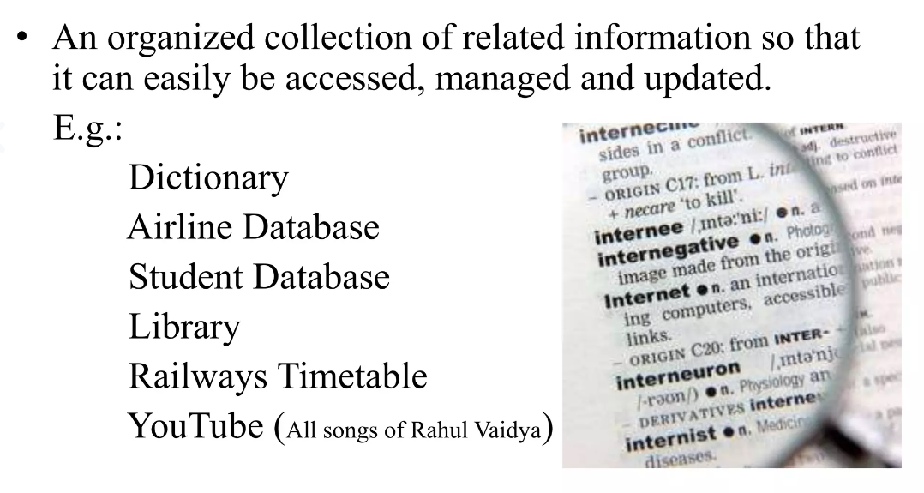
WHAT IS DATABASE ?

Slide 4

INTRODUCTION TO DBMS
DBMS Stand For DATABASE MANAGEMENT SYSTEM
DBMS is a software system for creating, organizing, and managing the database.

Slide 5
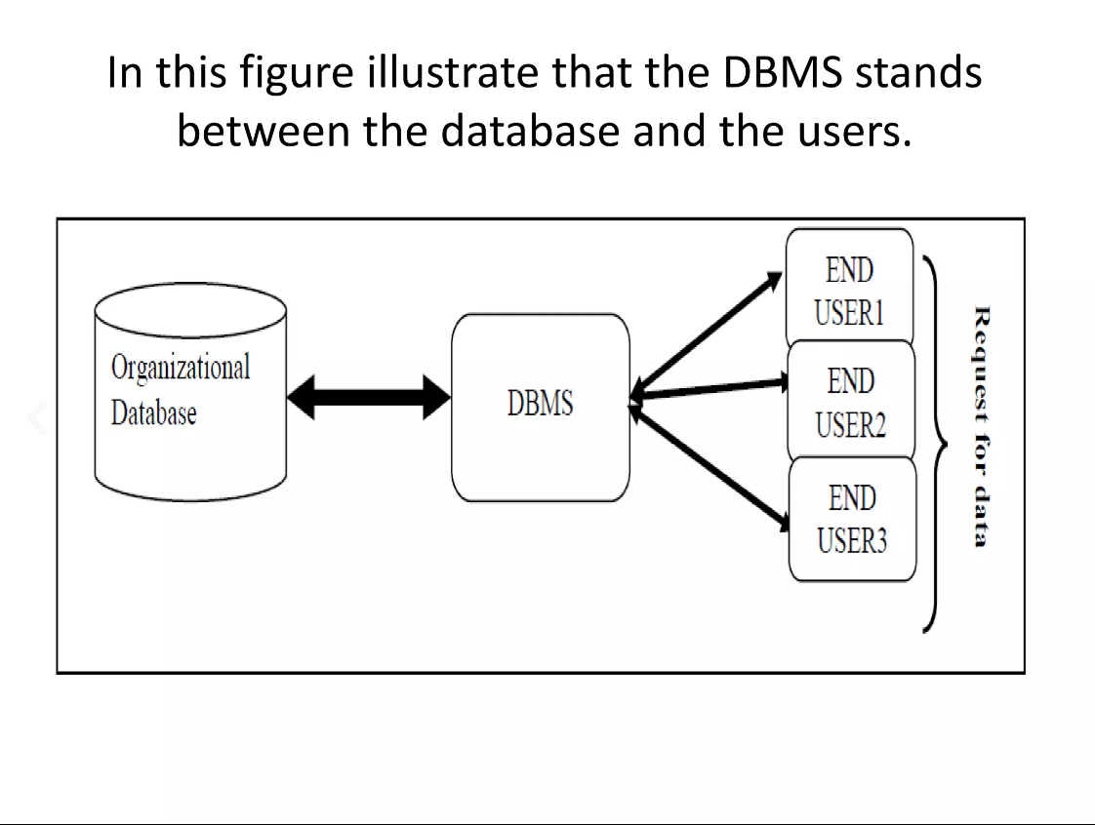

Slide 6
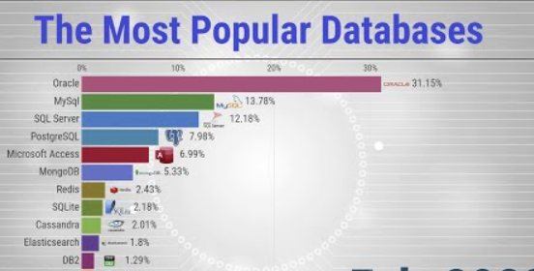

Slide 7
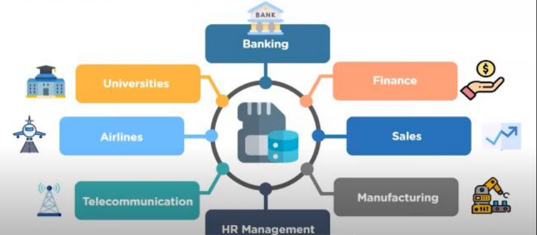
APPLICATION OF DBMS

Slide 8
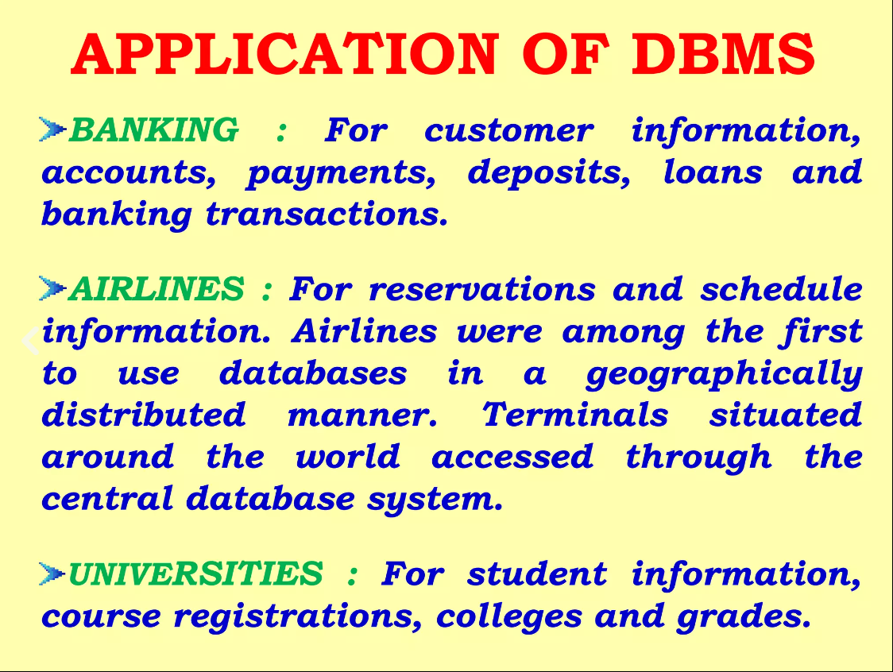

Slide 9
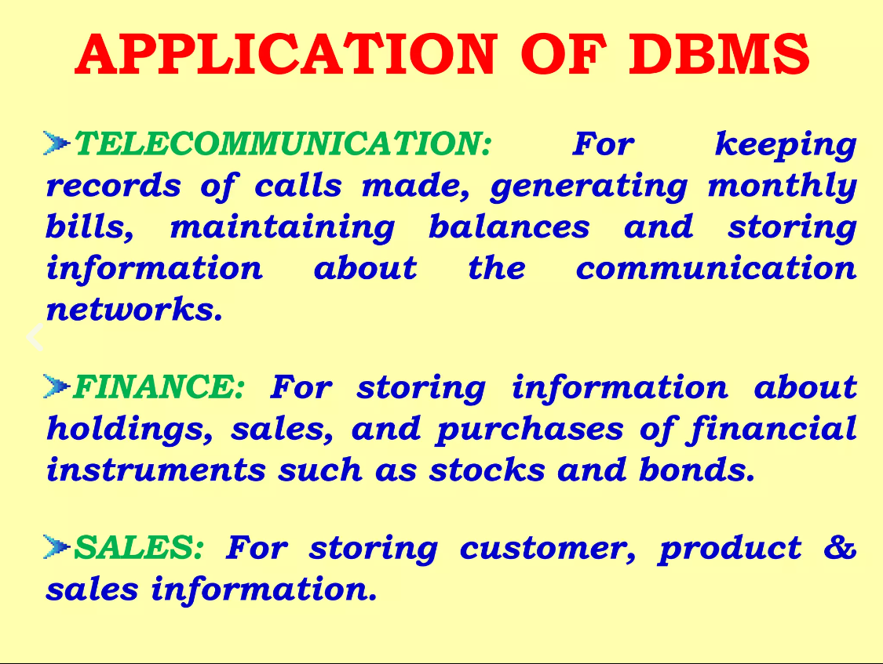

Slide 10
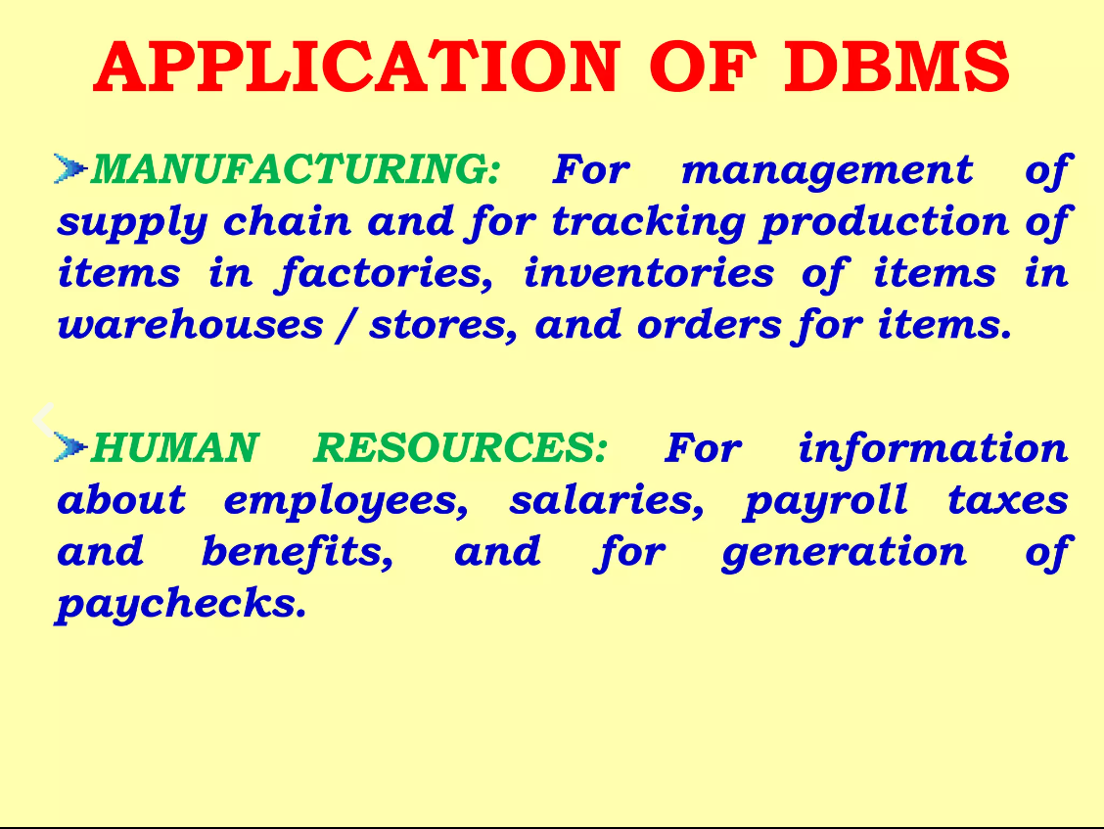

Slide 11
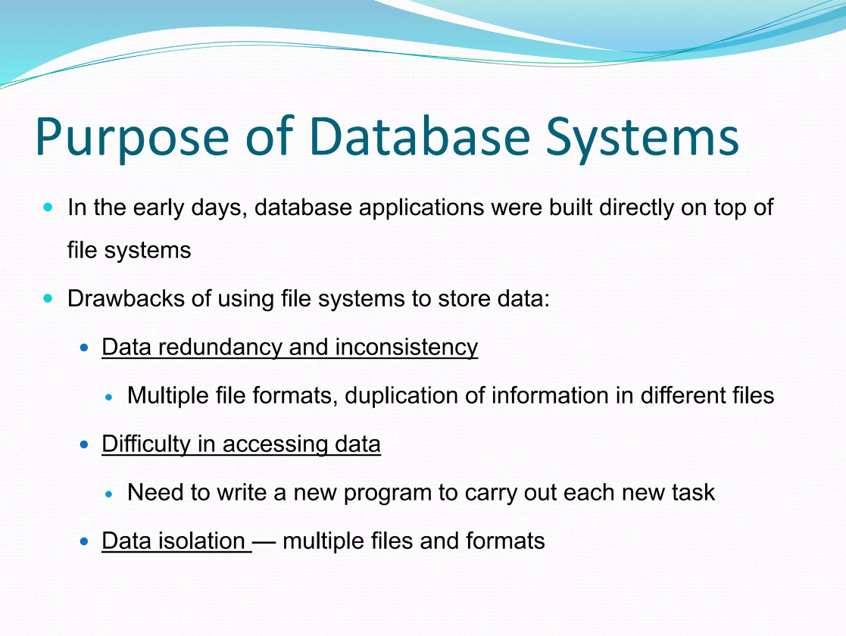

Slide 12
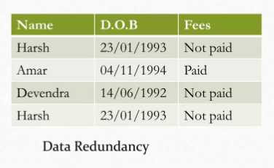

EXAMPLE OF redundancy and inconsistency

Slide 13
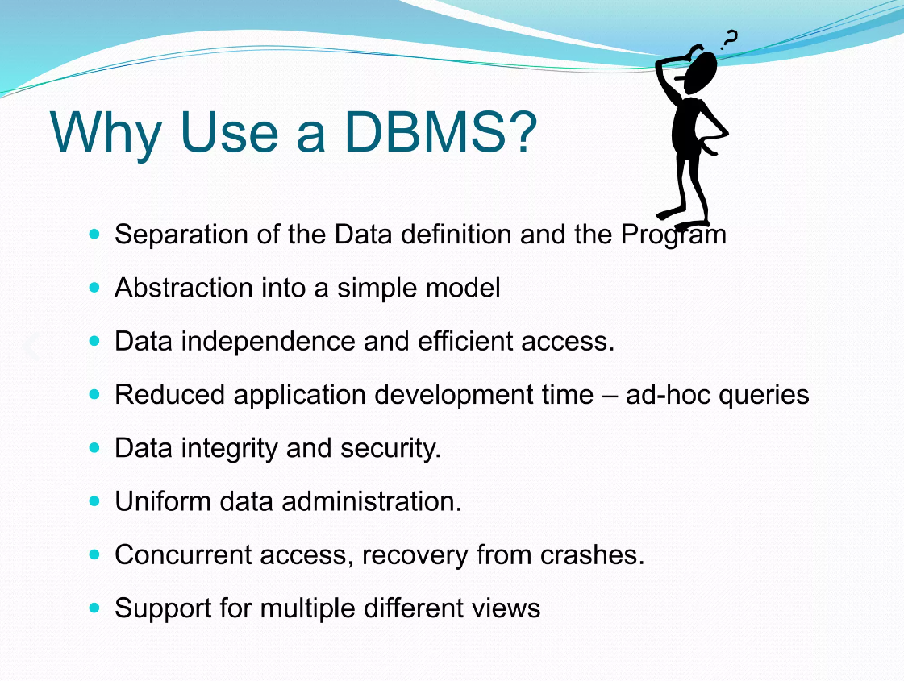

Slide 14
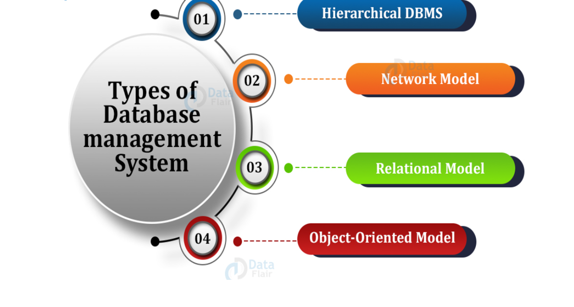

Slide 15
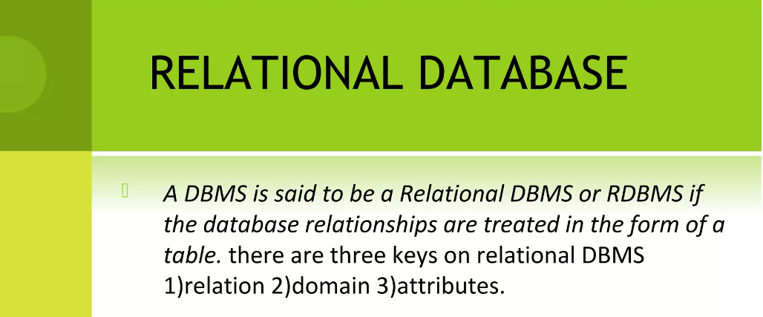

Slide 16
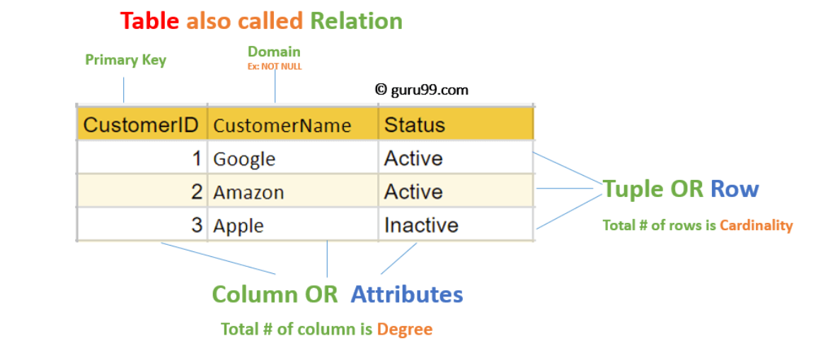

FIGURE OF RELATIONAL DBMS

Slide 17
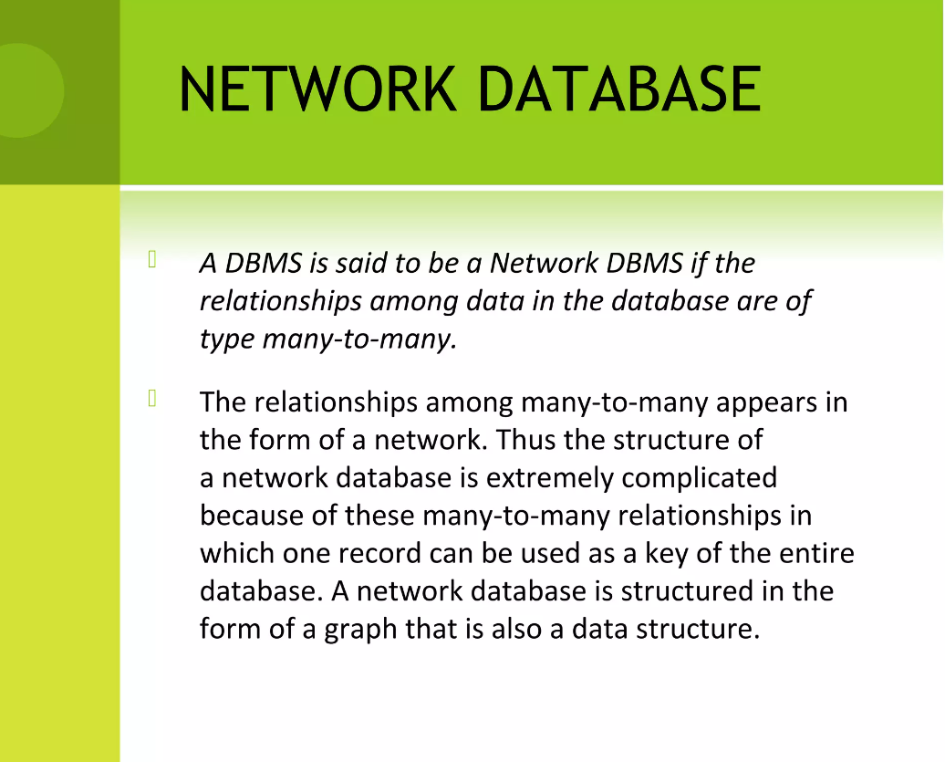

Slide 18
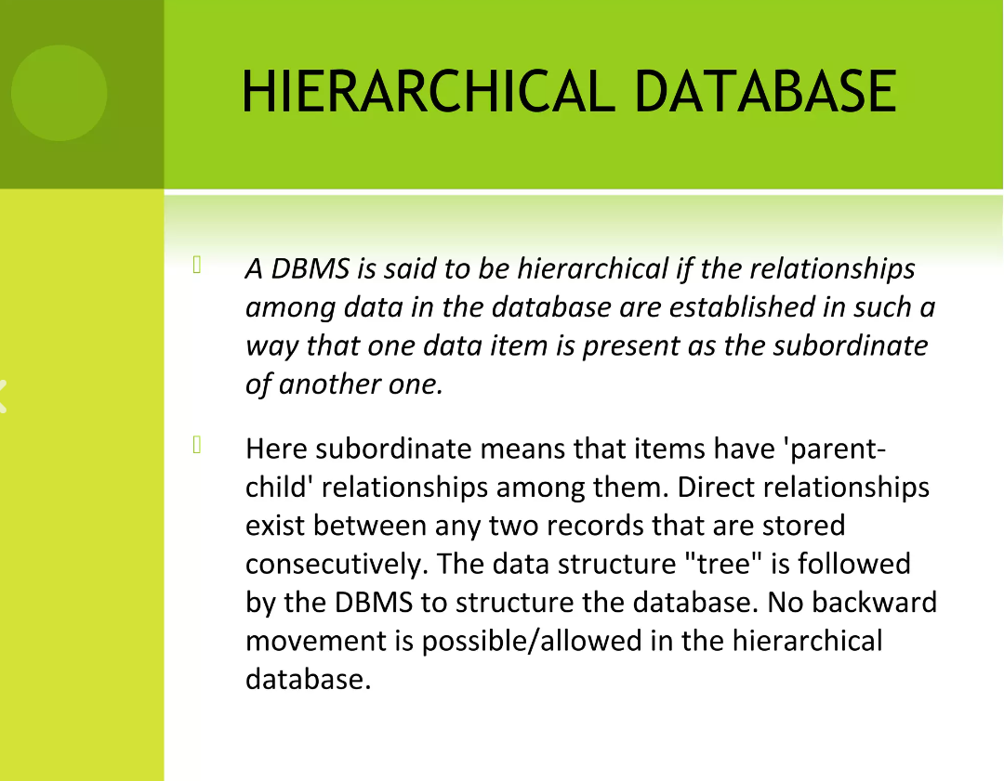

Slide 19
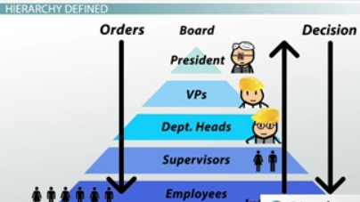

Slide 20
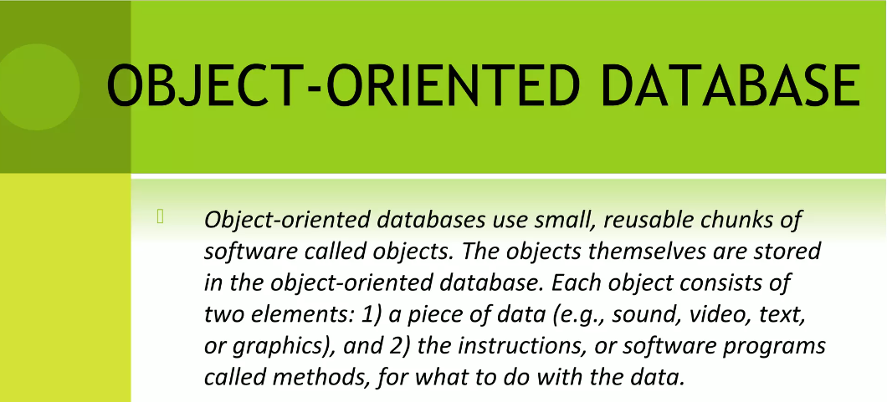

Slide 21
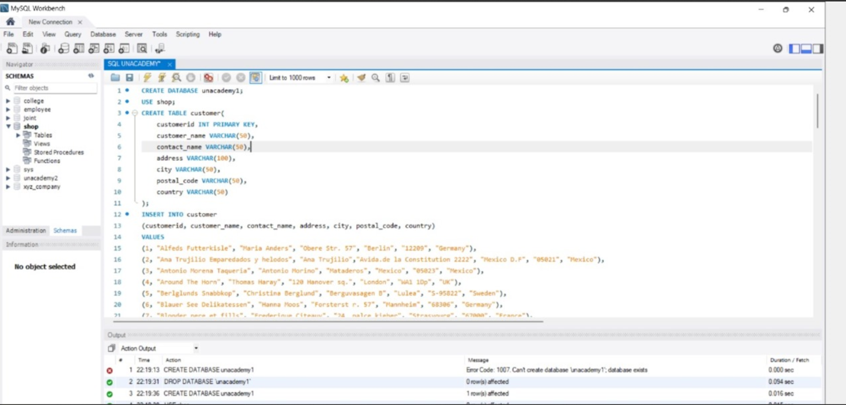
SQL Practical

Slide 22
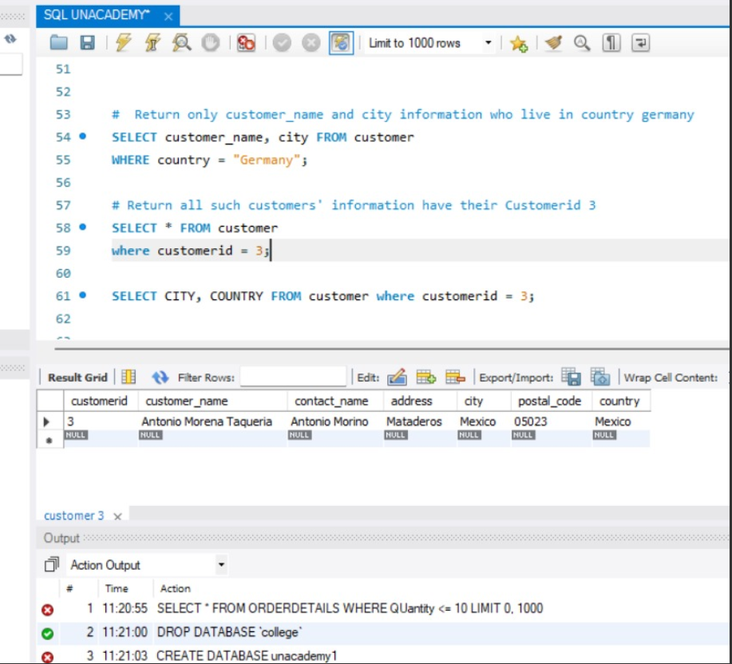

Slide 23
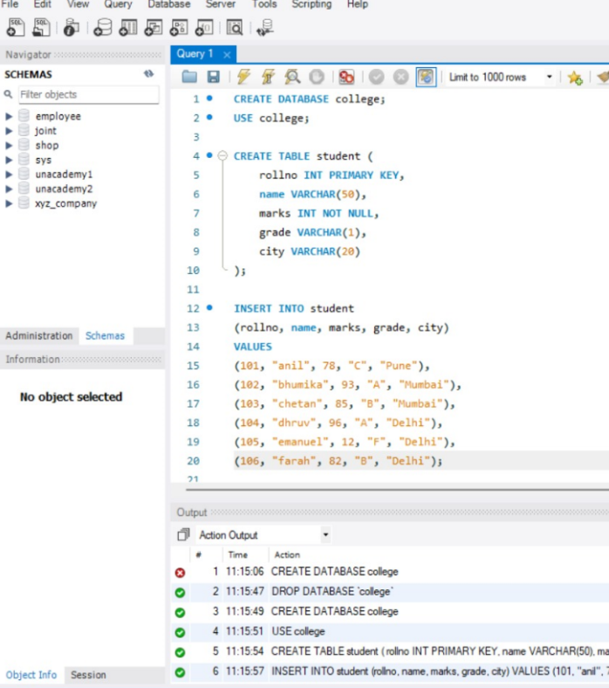
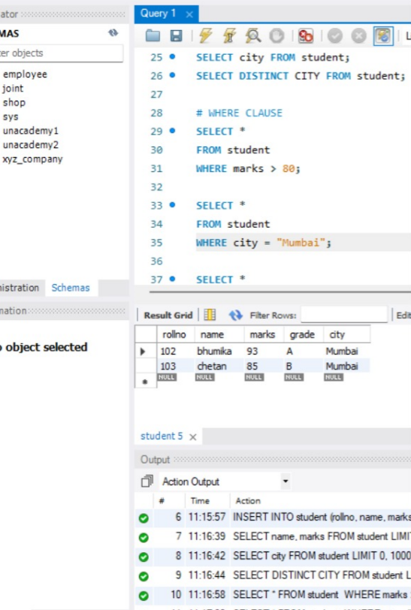

Slide 24
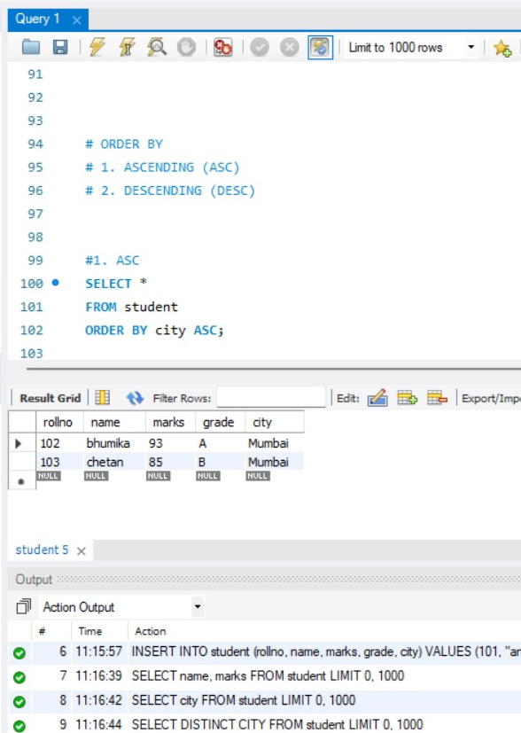

Slide 25


